Slide 1
Demand-Weighted ATM Network Optimization Under Scenario-Based Demand Variability
Ciara Cameron
MSML 604-PCS3

Slide 2
Problem
Why is ATM placement difficult?
Too few ATM locations = longer travel
Too many ATM locations = unnecessary cost
Demand varies across regions

Slide 3
Objective
Minimize travel distance
Account for demand differences
Evaluate impact of changing demand patterns

Slide 4
What Makes This Different?
Demand-weighted optimization
Scenario-based analysis
Stability and sensitivity analysis

Slide 5
Data & Setup
5 regions (DC, Silver Spring, Bowie, Annapolis, Waldorf)
~215 members (synthetic)
Fixed candidate ATM locations

Slide 6
Model
Assign members to nearest ATM location
Minimize total weighted travel distance
Select K ATM locations

Slide 7

Assignment vs Coverage
Assignment:
Each member is assigned to the nearest ATM location
Coverage:
Members must be within service radius ($r=0.08$)
Shows how minimizing distance is different than making sure members are actually within reach of an ATM

Slide 8
Scenarios
Baseline
Urban Demand Increase
Suburban Demand Increase
Demand Variability

Slide 9
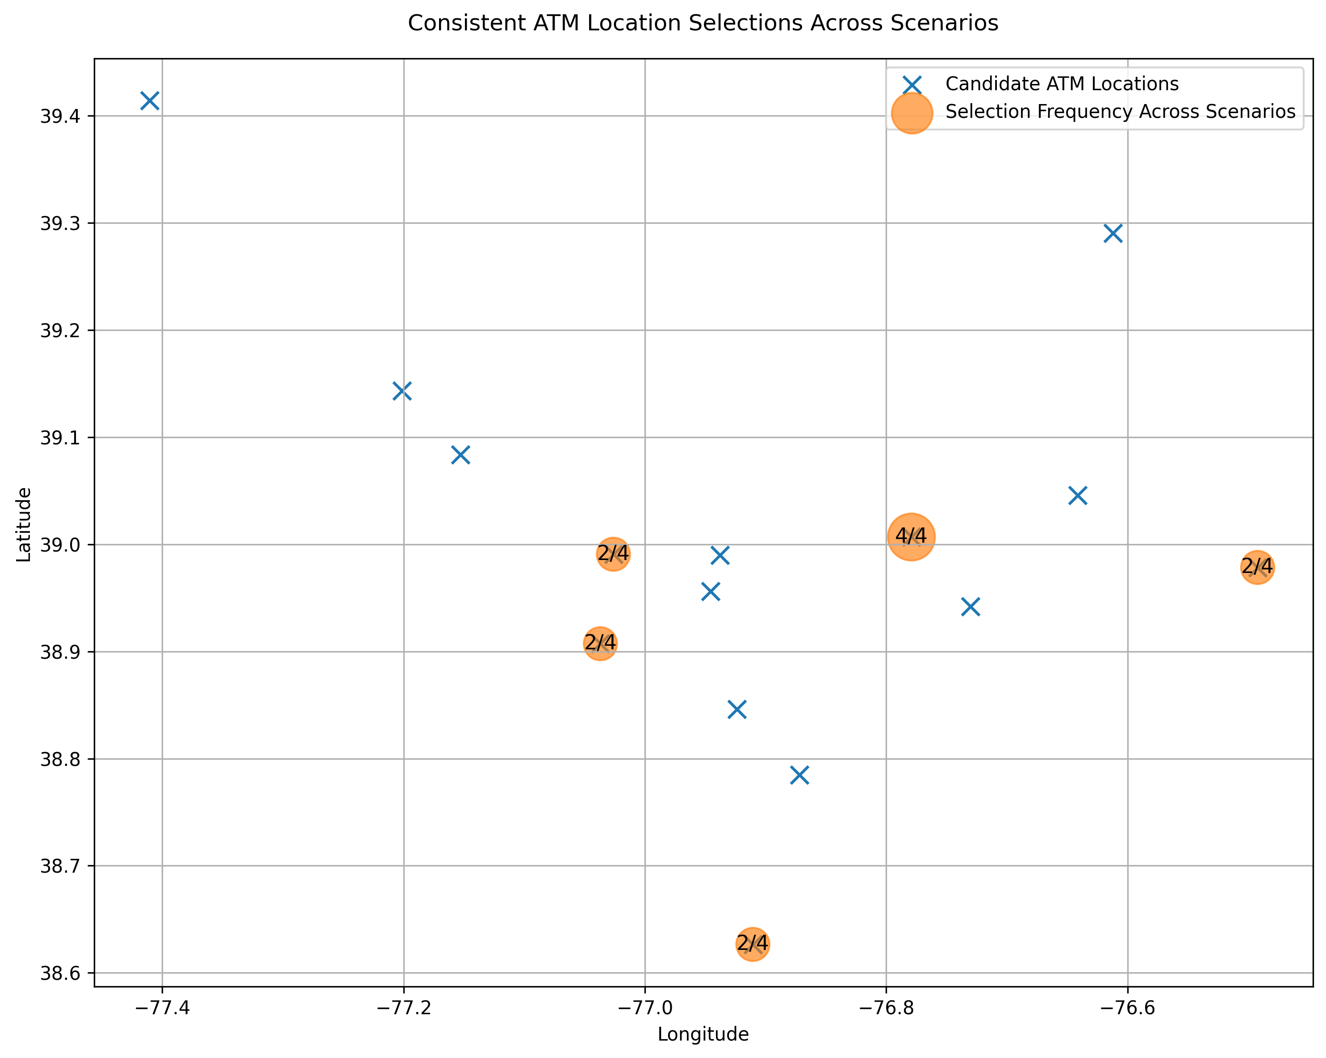
ATM Placements
ATM locations remain consistent across scenarios
Driven by geographic clustering of members

Slide 10
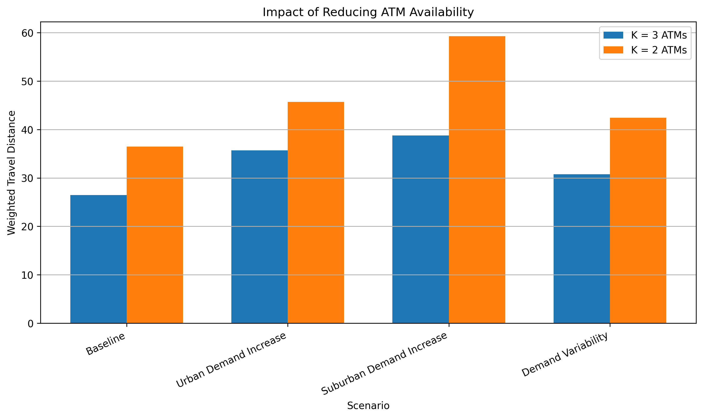
Impact of Reducing ATM Locations
Reducing from K=3 to K=2 increases travel distance
Largest impact happens under suburban demand
Results are sensitive to demand distribution

Slide 11
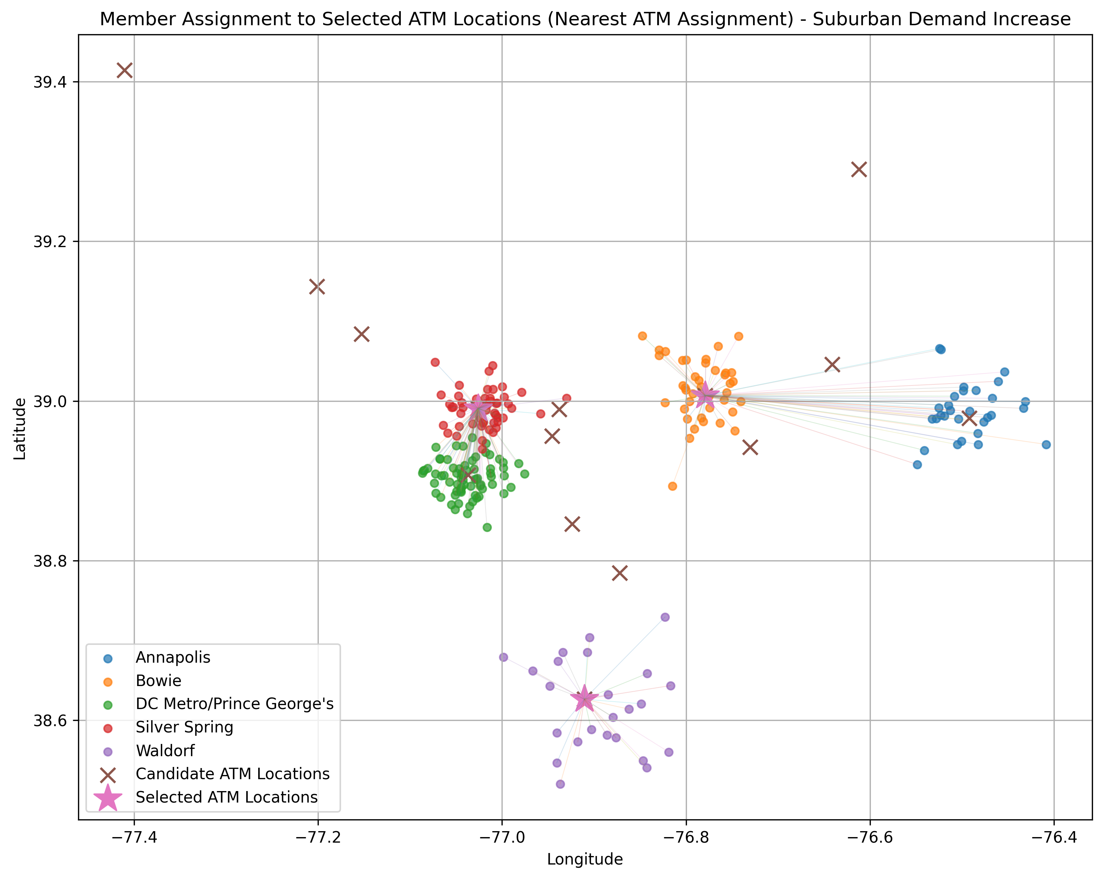
Suburban Demand Shift
Assignments shift toward suburban regions
More members are served by the Waldorf location
Urban clusters rely less on central ATMs

Slide 12
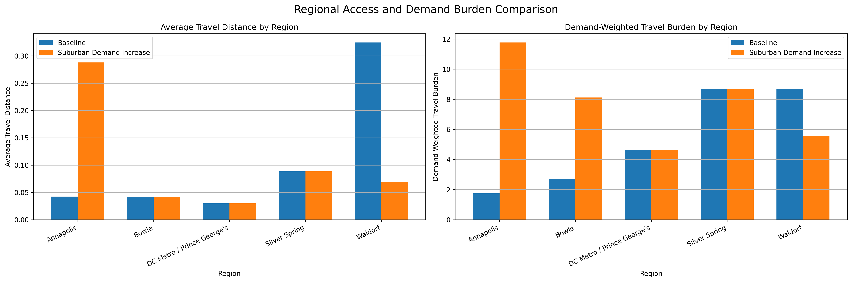
Efficiency vs Fairness
High-demand areas prioritized
Low-demand areas have longer travel distances
Tradeoff between efficiency and equal access

Slide 13
Key Takeaway
Placement is stable
Travel distance is not stable
Demand distribution matters

